Slide 1
ROCK PAPER SCISSOR LIZARD SPOCK
Sourabh kulkarni | FSJ0220A007

Slide 2

About The Project
Your description goes here….

Slide 3
Why This Project
Reason 1: Popular and most played game by all age group.
Reason 2: Time killer and creates competition environment.
Reason 3:Easy and simple to play.

Slide 4
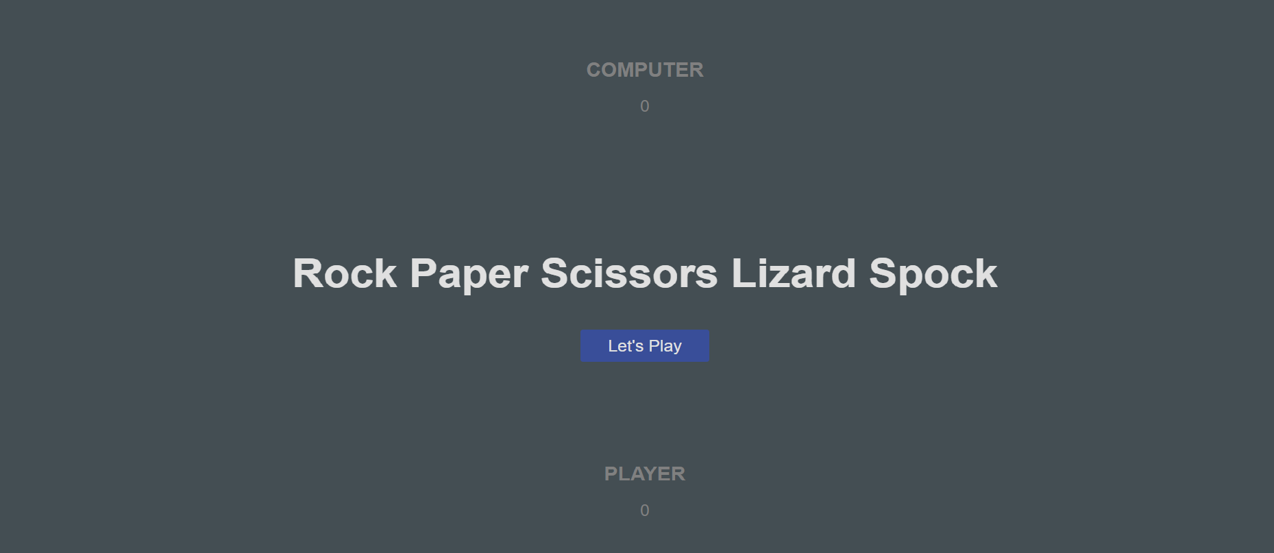
The Project

Slide 5
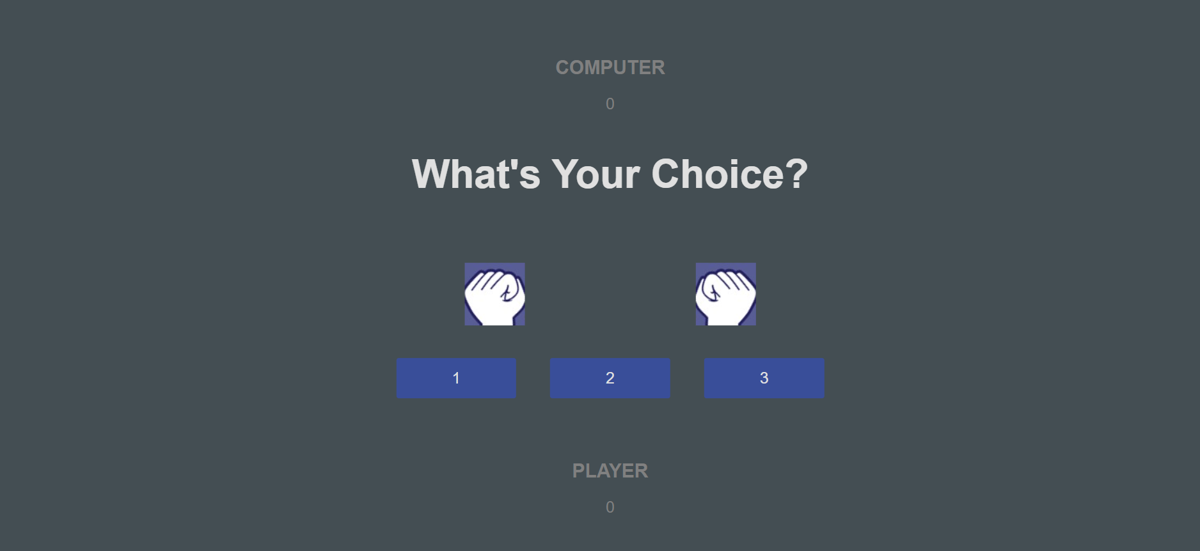
The Project

Slide 6
Concepts Used To Implement This Project
1. Concept 1: creating my html skeleton
2. Concept 2: styling the game
3. Concept 3: writing code using javascript
4. Concept 4:creating animations
5. Concept 5: launching game with github

Slide 7
The Challenges Faced
01
02
03
Challenge 1: Building logic for game became challenging for me.
Challenge 2: writing the code in javascript for my game was also a challenging part for me.
Challenge 3: TIME=>managing my time was a great challenge for me, i guess i managed it very well as the days went on.

Slide 8

Thank You

